Slide 1
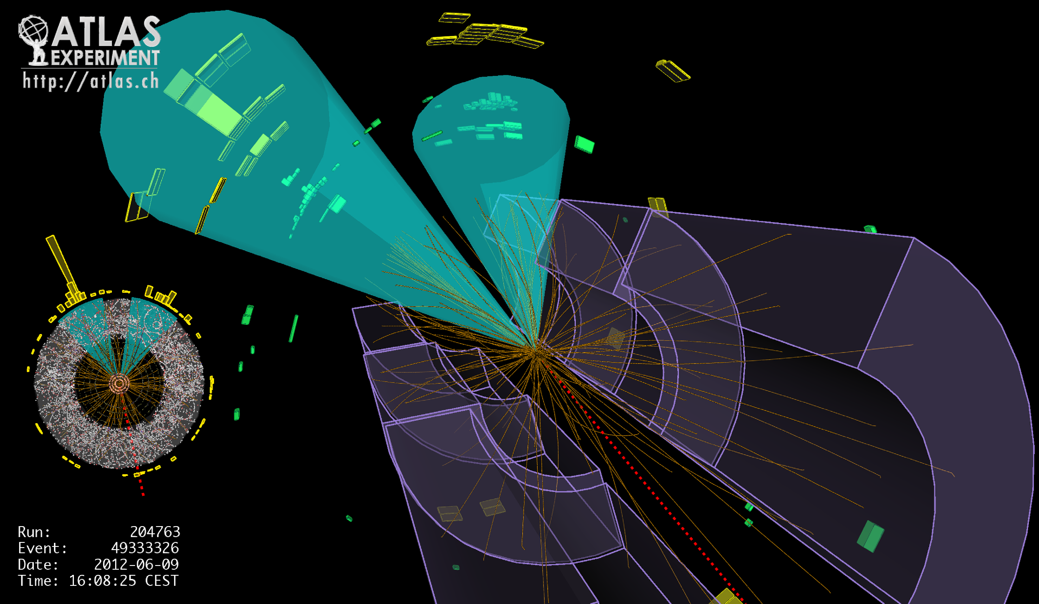
Lecture #2
Prof. Dr. Florencia Canelli
Universität Zürich
Elementary particle physics - PHY451
HS2016
Credits: CERN Summer lectures (di Lella), Hadron collider lectures

Slide 2
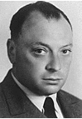
Pauli’s exclusion principle
In Quantum Mechanics the electron orbits around the nucleus are “quantized”:
only some specific orbits (characterized by integer quantum numbers) are possible.
Example: allowed orbit radii and energies for the Hydrogen atom
W. Pauli
m = m_{e}m_{p}/(m_{e} + m_{p})
n = 1, 2, ......
In atoms with Z > 2 only two electrons are found in the innermost orbit – WHY?
ANSWER (Pauli, 1925): two electrons (spin = ½) can never be in the same physical state
Hydrogen (Z = 1) Helium (Z = 2) Lithium (Z = 3) .....
Lowest
energy
state
Pauli’s exclusion principle applies to all particles with half-integer spin (Fermions)

Slide 3
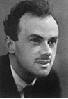
Antimatter
Postulated theoretically by P.A.M. Dirac (1928)
Dirac’s equation: a relativistic wave equation for the electron
Two surprising results:
P.A.M. Dirac
Motion of an electron in an electromagnetic field:
presence of a term describing (for slow electrons) the
potential energy of a magnetic dipole moment in a magnetic field
⇒ existence of an intrinsic electron magnetic dipole moment opposite to spin
electron spin
electron
magnetic dipole
moment μ_{e}
For each solution of Dirac’s equation with electron energy E > 0
there is another solution with E < 0
What is the physical meaning of these “negative energy” solutions ?

Slide 4
Antimatter
Generic solutions of Dirac’s equation: complex wave functions Ψ( r , t)
In the presence of an electromagnetic field, for each negative-energy solution
the complex conjugate wave function Ψ* is a positive-energy solution of
Dirac’s equation for an electron with opposite electric charge (+e)
Dirac’s assumptions:
nearly all electron negative-energy states are occupied and are not observable.
electron transitions from a positive-energy to an occupied negative-energy state
are forbidden by Pauli’s exclusion principle.
electron transitions from a positive-energy state to an empty negative-energy
state are allowed ⇒ electron disappearance. To conserve electric charge,
a positive electron (positron) must disappear ⇒ e⁺e– annihilation.
electron transitions from a negative-energy state to an empty positive-energy
state are also allowed ⇒ electron appearance. To conserve electric charge,
a positron must appear ⇒ creation of an e⁺e– pair.
⇒ empty electron negative–energy states describe positive energy states of the positron.
Dirac’s perfect vacuum: a region where all positive-energy states are empty
and all negative-energy states are full.
Positron magnetic dipole moment = μ_{e} but oriented parallel to positron spin

Slide 5
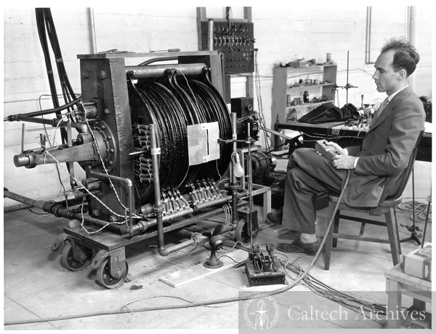
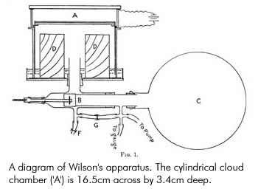
Discovery of antimatter
Discovered by C. D. Anderson, 1932 while studying cosmic-ray particles
Detector: a Wilson cloud – chamber (visual detector based on a gas volume containing vapor close to saturation) in a magnetic field, exposed to cosmic rays
C. Anderson
Find more details at the end of this lecture
A modern cloud chamber (video)
Chamber inserted in a 1.7 T magnet
Camera set on the side of the magnet
Lead plate to distinguish particles were moving upwards or downwards

Slide 6
Discovery of antimatter
Measure particle momentum and sign of electric charge from magnetic curvature
Lorentz force
projection of the particle trajectory in a plane
perpendicular to B is a circle
Circle radius for electric charge |e|:
: momentum component perpendicular
to magnetic field direction
–e
NOTE: impossible to distinguish between
positively and negatively charged
particles going in opposite directions
+e
need an independent determination of
the particle direction of motion

Slide 7
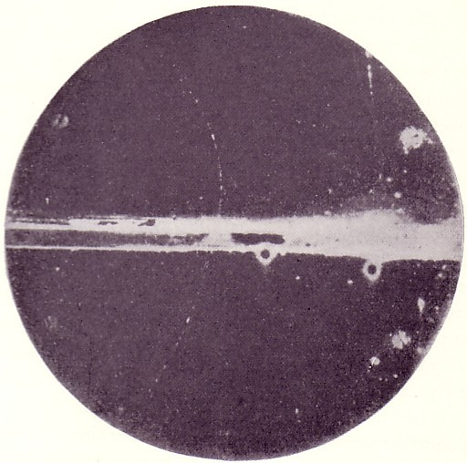
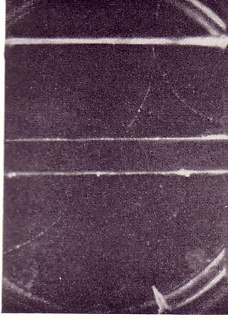
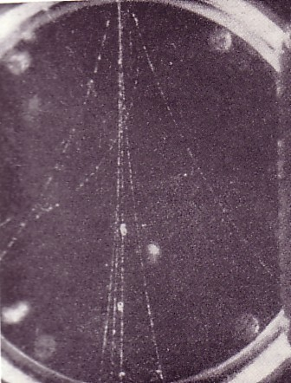
23 MeV positron
First experimental observation
of a positron
6 mm thick Pb plate
direction of
high-energy photon
63 MeV positron
Production of an
electron-positron pair
by a high-energy photon
in a Pb plate
Cosmic-ray “shower”
containing several e⁺ e– pairs

Slide 8
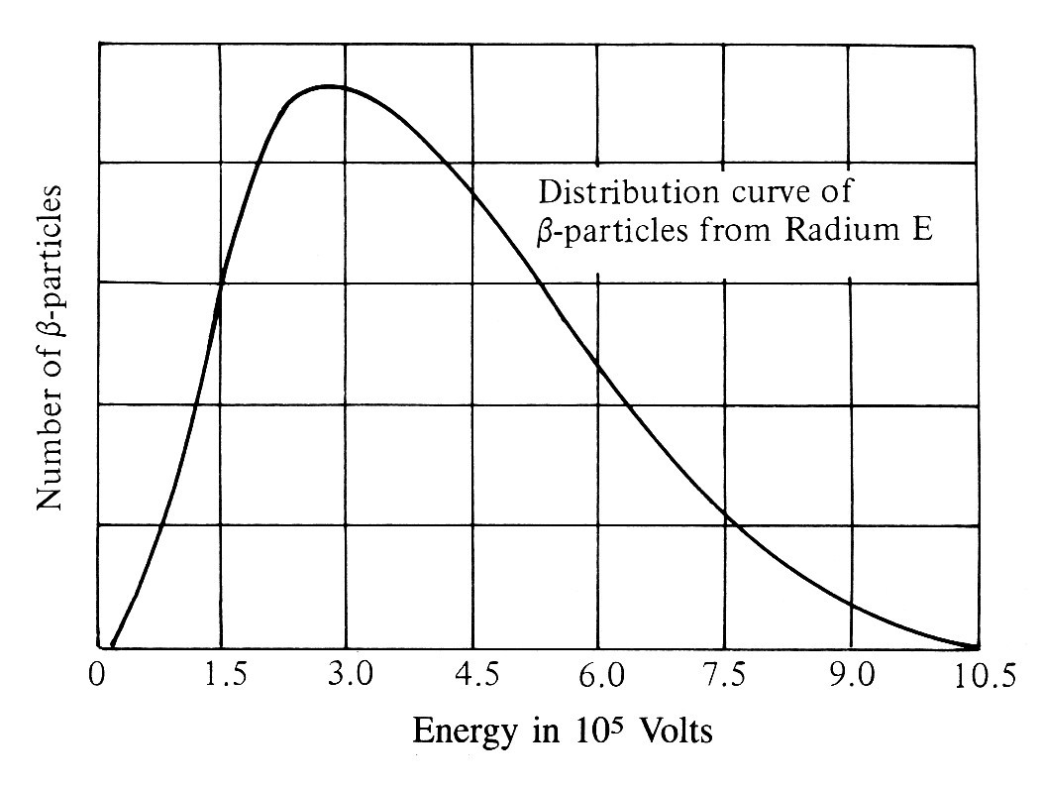
Neutrinos
A puzzle in β – decay: the continuous electron energy spectrum
First measurement by Chadwick (1914)
Radium E: ²¹⁰Bi₈₃
(a radioactive isotope
produced in the decay chain of ²³⁸U)
If β – decay is (A, Z) → (A, Z+1) + e–, then the emitted electron is mono-energetic:
electron total energy E = [M(A, Z) – M(A, Z+1)]c²
(neglecting the kinetic energy of the recoil nucleus ½p²/M(A,Z+1) << E)
Several solutions to the puzzle proposed before the 1930’s (all wrong), including
violation of energy conservation in β – decay

Slide 9
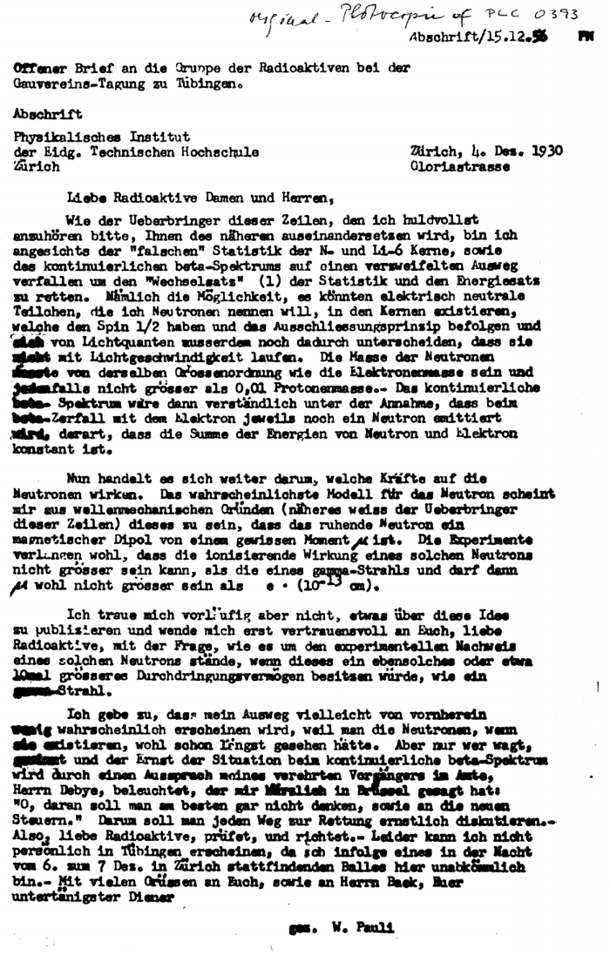
December 1930: public letter sent by W. Pauli to a physics meeting in Tübingen
Zürich, Dec. 4, 1930
Dear Radioactive Ladies and Gentlemen,
...because of the “wrong” statistics of the N and ⁶Li nuclei and the continuous β-spectrum, I have hit upon a desperate remedy to save the law of conservation of energy. Namely, the possibility that there could exist in the nuclei electrically neutral particles, that I wish to call neutrons, which have spin ½ and obey the exclusion principle ..... The mass of the neutrons should be of the same order of magnitude as the electron mass and in any event not larger than 0.01 proton masses. The continuous β-spectrum would then become understandable by the assumption that in β-decay a neutron is emitted in addition to the electron such that the sum of the energies of the neutron and electron is constant.
....... For the moment, however, I do not dare to publish anything on this idea ......
So, dear Radioactives, examine and judge it. Unfortunately I cannot appear in Tübingen
personally, since I am indispensable here in Zürich because of a ball on the night of
6/7 December. ....
W. Pauli
NOTES
Pauli’s neutron is a light particle ⇒ not the neutron that will be discovered by Chadwick
one year later
As everybody else at that time, Pauli believed that if radioactive nuclei emit particles,
these particles must exist in the nuclei before emission

Slide 10
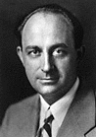
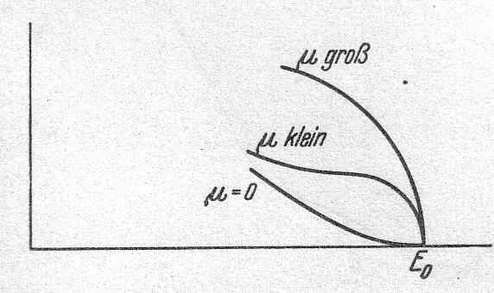
Theory of β-decay
Theory of weak interactions postulated by E. Fermi, 1932
β⁻ decay: n → p + e⁻ + ν
β⁺ decay: p → n + e⁺ + ν (e.g., ¹⁴O₈ → ¹⁴N₇ + e⁺ + ν)
E. Fermi
ν: the particle proposed by Pauli
(named “neutrino” by Fermi)
ν: its antiparticle (antineutrino)
Fermi’s theory: a point interaction among four spin ½ particles, using
the mathematical formalism of creation and annihilation
operators invented by Jordan
⇒ particles emitted in β – decay do not exist before emission –
they are “created” at the instant of decay
Prediction of β – decay rates and electron energy spectra as a function of
only one parameter: Fermi coupling constant G_{F} (determined from experiments)
Energy spectrum dependence on neutrino mass μ
(from Fermi’s original article, published in German
on Zeitschrift für Physik, following rejection of the
English version by Nature)
Measurable distortions for μ > 0 near the end-point
(E₀ : max. allowed electron energy)

Slide 11
Neutrino detection
Prediction of Fermi’s theory: ν + p → e⁺ + n
ν – p interaction probability in thickness dx of hydrogen-rich material (e.g., H₂O)
Incident ν:
Flux Φ [ ν cm^{–2} s^{–1} ]
(uniform over surface S)
Target:
surface S, thickness dx
containing n protons cm^{–3}
dx
ν p interaction rate = Φ S n σ dx interactions per second
σ : ν – proton cross-section (effective proton area, as seen by the incident ν )
ν p interaction probability = n σ dx = dx / λ
Interaction mean free path: λ = 1 / n σ
Interaction probability for finite target thickness T = 1 – exp(–T / λ)
σ( ν p) ≈ 10^{–4 3} cm² for 3 MeV ν ⇒ λ ≈ 150 light-years of water !
Interaction probability ≈ T / λ very small (~10^{–18} per meter H₂O)
⇒ need very intense sources for antineutrino detection

Slide 12
Nuclear reactors
Very intense antineutrino sources
Average fission: n + ²³⁵U₉₂ → (A₁, Z) + (A₂, 92 – Z) + 2.5 free neutrons + 200 MeV
nuclei with
large neutron excess
a chain of β decays with very short lifetimes:
(A, Z) (A, Z + 1) (A, Z + 2) ....
(until a stable or long lifetime
nucleus is reached)
e– ν
e– ν
e– ν
On average, 6 ν per fission
P_{t}: reactor thermal power [W]
conversion factor
MeV → J
For a typical reactor: P_{t} = 3 x 10⁹ W ⇒ 5.6 x 10²⁰ ν / s (isotropic)
Continuous ν energy spectrum – average energy ~3 MeV

Slide 13
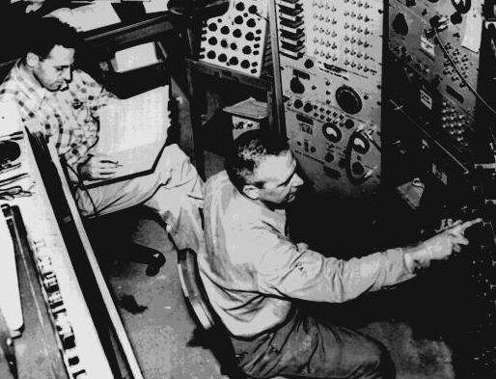
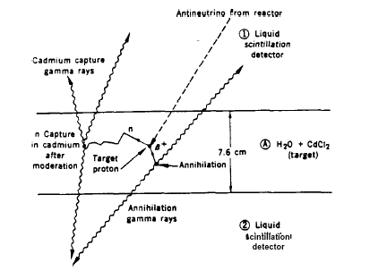
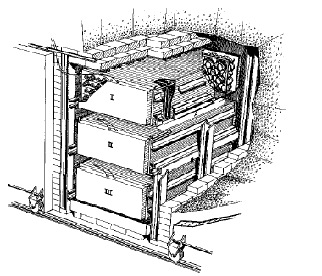
First neutrino detection
Idea from F. Reines and C. Cowan to use the pulse of huge neutrino flux coming out of a nuclear reactors, 1953
ν + p → e⁺ + n
F. Reines and C. Cowan
detect 0.5 MeV γ-rays from e⁺e– → γ γ
(t = 0)
neutron “thermalization” followed
by capture in Cd nuclei ⇒ emission
of delayed γ-rays (average delay ~30 μs)
E_{γ} = 0.5 MeV
2 m
H₂O +
CdCl₂
Event rate at the Savannah River
nuclear power plant:
3.0 ± 0.2 events / hour
(after subtracting event rate measured
with reactor OFF )
in agreement with expectations
I, II, III:
Liquid scintillator

Slide 14
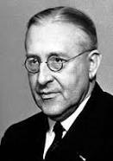
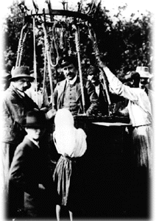
Cosmic rays discovery
Discovered by V.F. Hess in the 1910’s by observing the increase of radioactivity with altitude during a balloon flight (~5000 m)
Until the late 1940’s, the only existing source of high-energy particles
Cloud chambers were used to observe tracks made by cosmic rays
V. Hess

Slide 15
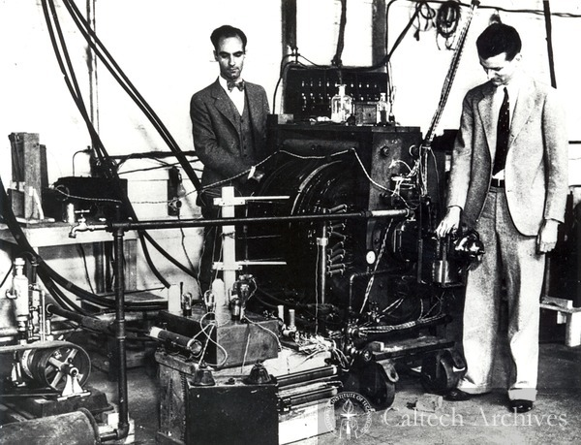
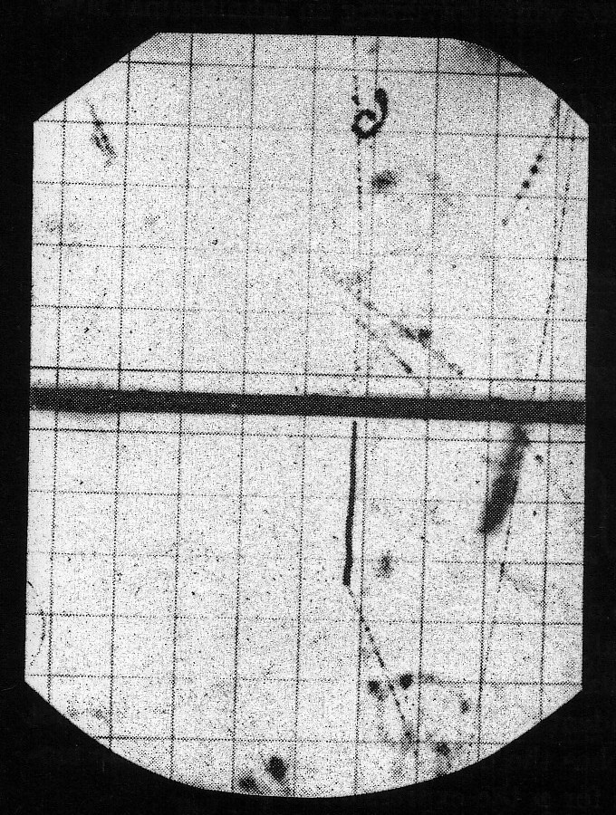
Discovery of the muon
Observed by C. Anderson and S. Neddermeyer, 1937
Confirmed and improved by J. Street and E. Stevenson, 1937
C. Anderson & S. Neddermeyer
μ
Observations:
Mass larger than a free electron
Mass much smaller than a proton
Positive and negative charges
Cosmic ray muon stopping
in a cloud chamber and
decaying to an electron
Platinum plate
Determination of the mass by simultaneous measurement of momentum p = mv(1 – v²/c²)^{-½} (track curvature in magnetic field) and velocity v (ionization):
m_{μ} = 105.66 MeV/c² ≈ 207 m_{e}
decay electron track

Slide 16
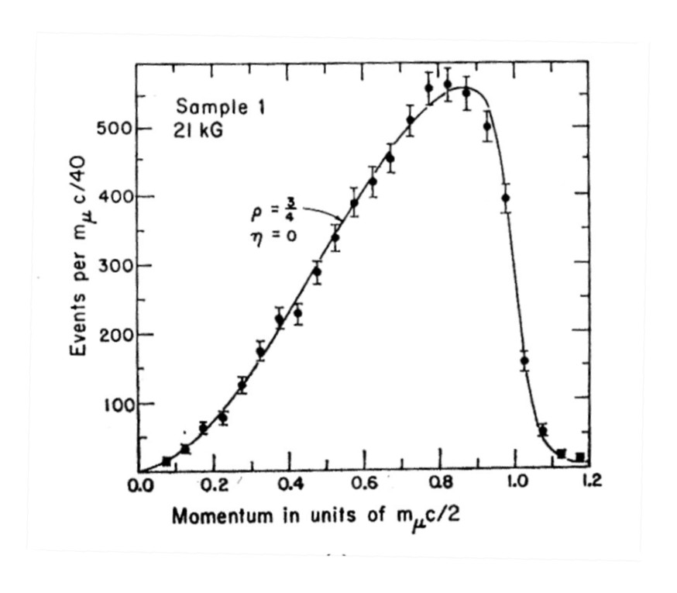
Decay of the muon
μ± → e± + ν + ν
Decay electron momentum distribution
Muon spin = ½
Muon lifetime at rest: τ_{μ} = 2.197 x 10 ⁻ ⁶ s ≡ 2.197 μs
Muon decay mean free path in flight:
p : muon momentum
τ_{μ} c ≈ 0.66 km
⇒ muons can reach the Earth surface after a path ≥ 10 km because
the decay mean free path is stretched by the relativistic time expansion

Slide 17
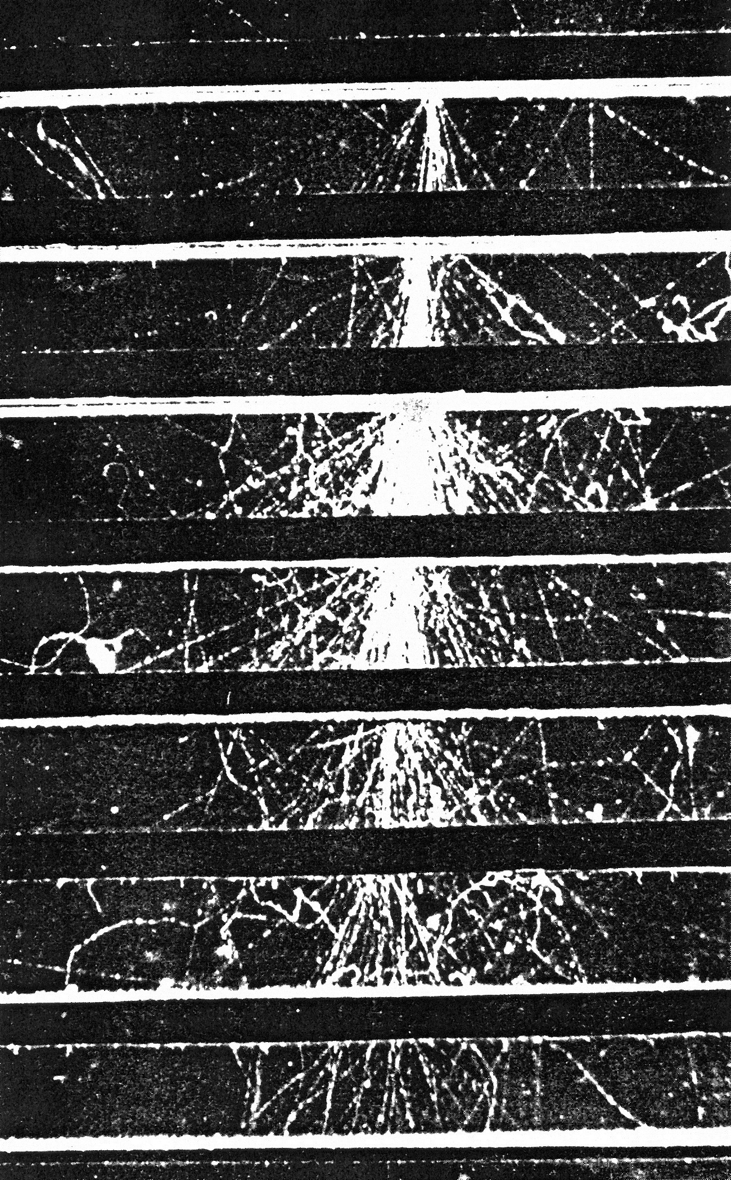
Cosmic rays
What we know now:
Cosmic rays at sea level have two main components
Electromagnetic “showers”, consisting of
many e± and γ-rays, mainly originating from:
γ + nucleus → e⁺e– + nucleus (pair production);
e± + nucleus → e± + γ + nucleus (“bremsstrahlung”)
The typical mean free path for these processes
(“radiation length”, x₀ ) depends on Z.
For Pb (Z = 82) x₀ = 0.56 cm
Thickness of the atmosphere ≈ 27 x₀
Muons ( μ± ) capable of traversing as much as 1 m of Pb
without interacting; tracks observed in cloud chambers
in the 1930’s.
Cloud chamber image of an
electromagnetic shower.
Pb plates, each 1. 27 cm thick

Slide 18
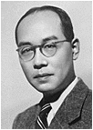
Theory of nuclear forces
H. Yukawa predicted the existence of a new light particle as the carrier of nuclear forces in 1935
Particle mass between electron and proton (“meson”)
H. Yukawa
Relation between interaction radius and meson mass m:
mc² ≈ 200 MeV
for R_{int} ≈ 10 ⁻¹³ cm
Yukawa’s meson initially identified with the muon – in this case μ– stopping
in matter should be immediately absorbed by nuclei ⇒ nuclear breakup
(not true for stopping μ⁺ because of Coulomb repulsion - μ⁺ never come close enough to nuclei, while μ– form “muonic” atoms)

Slide 19

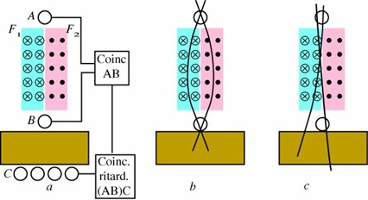
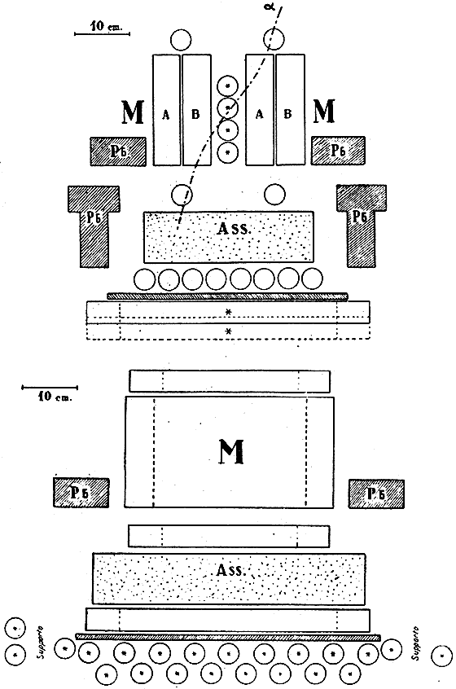
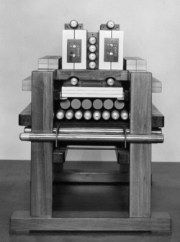
Discovery of the pion (I)
Experiment of M. Conversi, O. Pancini, E. Piccioni in Rome, 1945: study of μ– stopping in matter using μ– magnetic selection in the cosmic rays
M. Conversi, O. Piccioni & E. Pancini

Slide 20

Discovery of the pion (I)
Experiment of M. Conversi, O. Pancini, E. Piccioni in Rome, 1945: study of μ– stopping in matter using μ– magnetic selection in the cosmic rays
Here: documentary about their discovery
In light material (Z ≤ 10) the μ– decays mainly to electron (just as μ⁺)
In heavier material, the μ– disappears partly by decaying to electron,
and partly by nuclear capture (process later understood as μ– + p → n + ν).
However, the rate of nuclear captures is consistent with the weak interaction.
The muon is not Yukawa’s meson

Slide 21
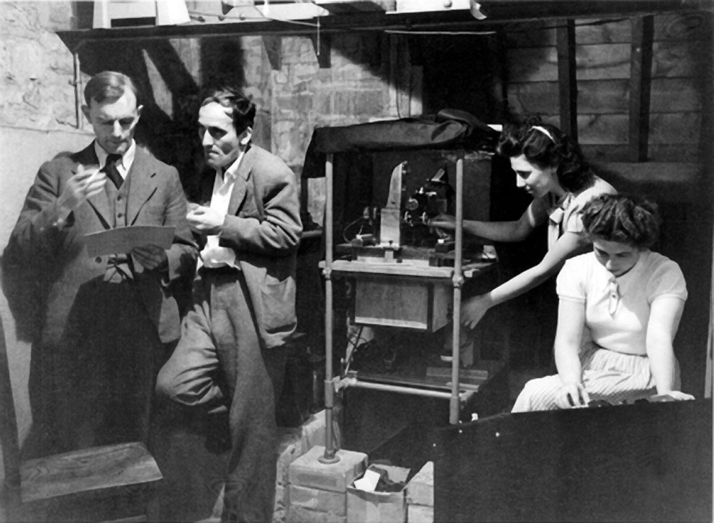
Discovery of the pion (II)
The work of Lattes, Occhialini, Powell in 1947 established that there were 2 different particles, and one decays into the other.
C. Powell, G. Occhialini
New detection technique: nuclear emulsion.
A detector sensitive to ionization with ~1 μm space resolution
(AgBr microcrystals suspended in gelatin)

Slide 22

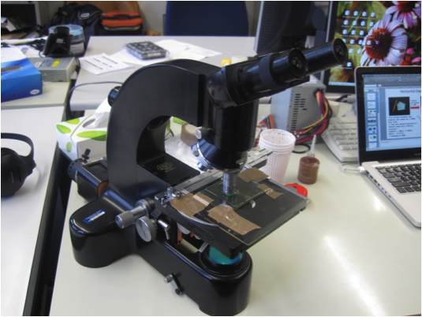
Nuclear emulsions
Nuclear Emulsion is a photographic plate which is used to record the tracks of charged particles
By 1940’s Powell et al. greatly improved the emulsion technique
Developing of electron sensitive Nuclear Emulsions. (Produced by ILFORD and KODAK)
In parallel, dedicated microscopes were developed
It consists of a large number of small crystals of silver halide, mostly bromide
Technique still in use in high energy physics, astronomy, astrophysics, etc.
Credits: M.Fatih BAY , U Bern
Click here for more information

Slide 23
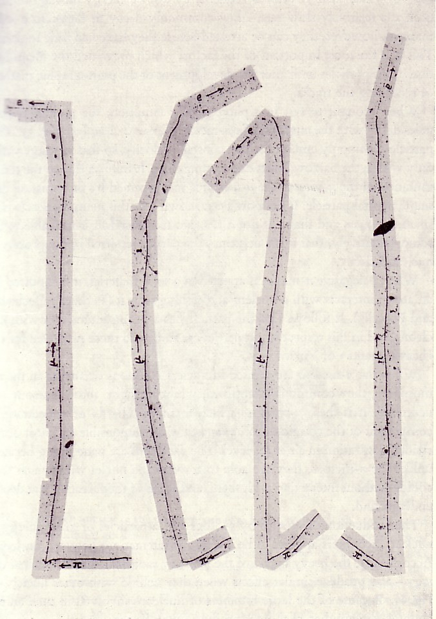
Discovery of the pion (II)
Observation of the π⁺ → μ⁺ → e⁺ decay chain in nuclear emulsion exposed to cosmic rays at high altitudes
In all events the muon has a fixed kinetic energy
(4.1 MeV, corresponding to a range of ~ 600 μm in
nuclear emulsion) ⇒ two-body decay
Four events showing the decay of a π⁺
coming to rest in nuclear emulsion
m_{π} = 139.57 MeV/c² ; spin = 0
Dominant decay mode: π⁺ → μ⁺ + ν
(and π – → μ– + ν )
Mean life at rest: τ_{π} = 2.6 x 10⁻⁸ s = 26 ns
π – at rest undergoes nuclear capture,
as expected for the Yukawa particle
A neutral π – meson (π°) also exists:
m (π°) = 134. 98 MeV /c²
Decay: π° → γ + γ , mean life = 8.4 x 10⁻¹⁷ s
π – mesons are the most copiously produced
particles in proton – proton and proton – nucleus
collisions at high energies

Slide 24
Extra material

Slide 25
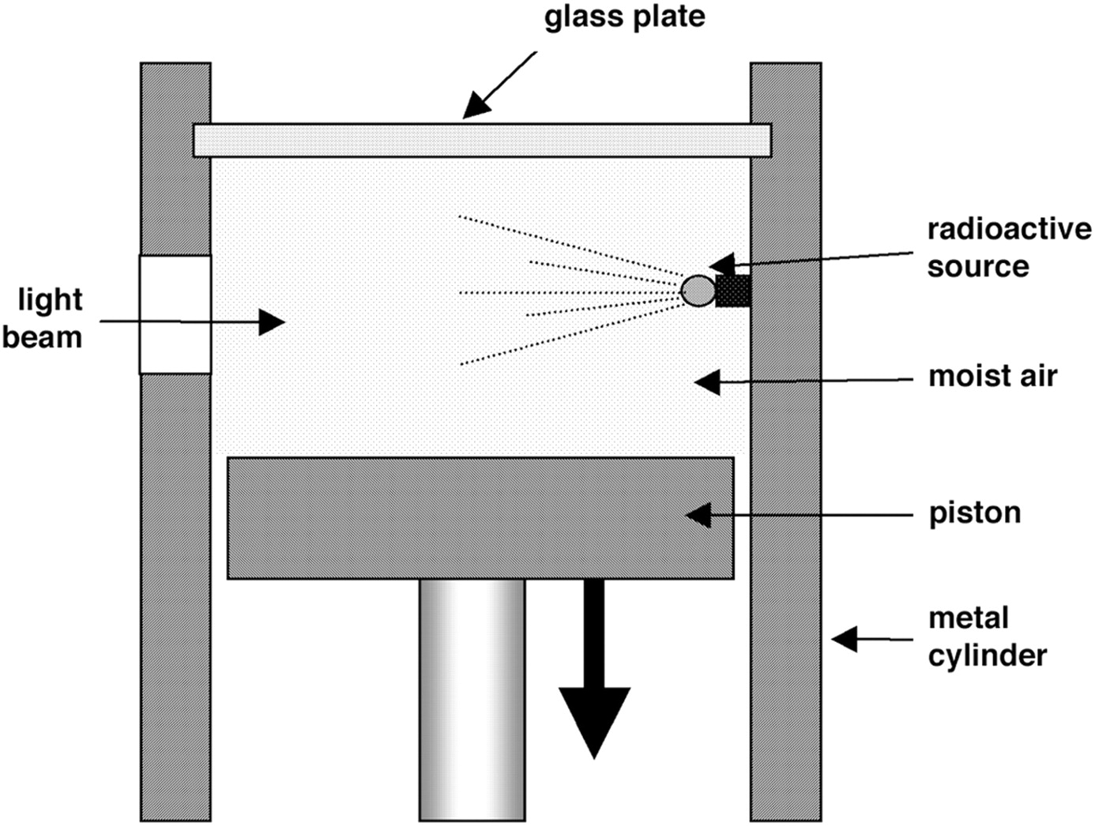
Cloud Chambers
The cloud chamber, also known as the Wilson chamber, is used for detecting particles of ionizing radiation. In its most basic form, a cloud chamber is a sealed environment containing a supercooled, supersaturated water or alcohol vapor. When an alpha particle or beta particle interacts with the mixture, it ionizes it.
Sudden descend of piston supersaturates chamber
and water droplets condense on any ions present
The resulting ions act as condensation nuclei, around which a mist will form (because the mixture is on the point of condensation). The high energies of alpha and beta particles mean that a trail is left, due to many ions being produced along the path of the charged particle. These tracks have distinctive shapes (for example, an alpha particle's track is broad and straight, while an electron's is thinner and shows more evidence of deflection by collisions). When any uniform magnetic field is applied across the cloud chamber, positively and negatively charged particles will curve in opposite directions, according to the Lorenz force law with two particles of opposite charge.

Slide 26
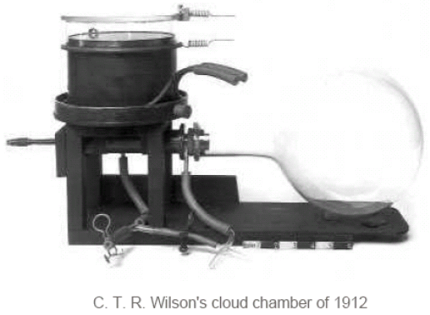
Cloud Chambers
Charles Thomas Rees Wilson (1869-1959) is credited with inventing the cloud chamber. Inspired by sightings of the Brocken Spectre while working on the summit of Ben Nevis in 1894, he began to develop expansion chambers for studying cloud formation and optical phenomena in moist air. Very rapidly he discovered that ions could act as centers for water droplet formation in such chambers. He pursued the application of this discovery and perfected the first cloud chamber in 1911.
C.T.R. Wilson’s cloud chamber of 1912
In Wilson's original chamber the air inside the sealed device was saturated with water vapor, then a diaphragm is used to expand the air inside the chamber (adiabatic expansion). This cools the air and water vapor starts to condense. When an ionizing particle passes through the chamber, water vapor condenses on the resulting ions and the trail of the particle is visible in the vapor cloud. A diagram of Wilson's apparatus is given left. C.T.R. Wilson, along with Arthur Compton, received the Nobel Prize for Physics in 1927 for his work on the cloud chamber.

Slide 27
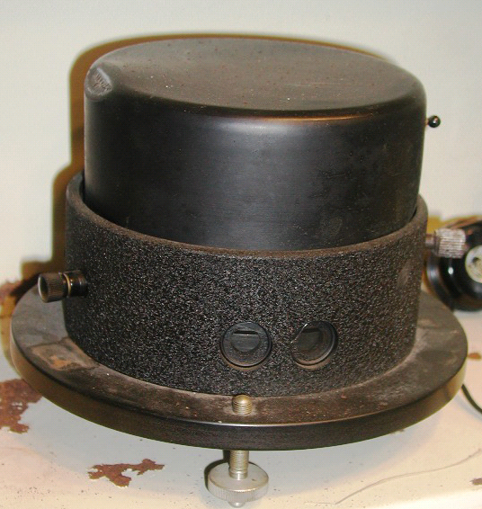
Cloud chambers
Rutherford and Mardsen used a Wilson cloud chamber, very similarly with the one from our collection, to study alpha particle scattering by light elements in hope to get deeper inside the nucleus (i.e. smaller Z). Rutherford and Mardsen occasionally observed in the their Wilson cloud chamber tracks up to 4 times longer (either four times larger energy or 2 times smaller charge). So, they introduced the notion of “H-particles” and speculate that they are nuclei of Hydrogen knocked out from atoms by alpha particles. And, so these became to be known as protons.
Mardsen observed similar “H-particles” in an air-filed Wilson cloud chamber, but did not have a chance to Pursue further …
Rutherford and Soddy are awarded the Nobel Prize for discovery of element transmutation

